Slide 1
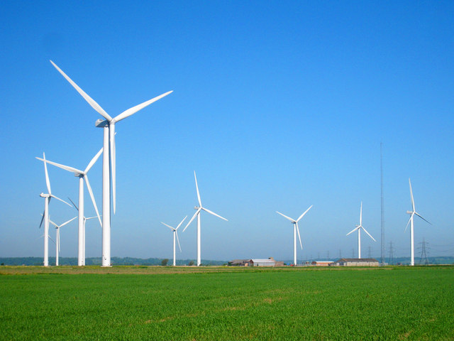
Weather

Slide 2
What is Weather?
Weather is the condition of the atmosphere and results from the interaction between the sun, the atmosphere, and the earth. Weather involves heat or cold, wetness or dryness, calm or storm, and clearness or cloudiness.

Slide 3
What is Air?
We live in a large pool of air. This air is called the atmosphere. It is made up of mostly colorless, odorless gases. These include nitrogen, oxygen, and carbon dioxide.

Slide 4
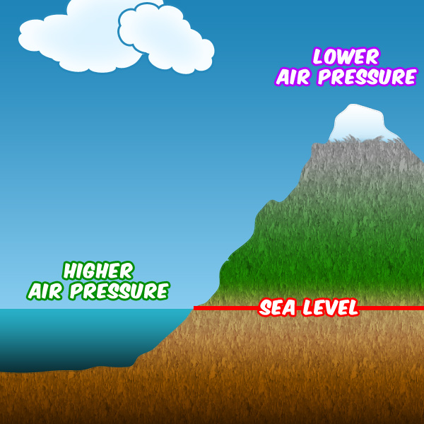
What is Air Pressure?
The weight of all this air weighing down on us is what’s known as air pressure. The more air that is above us, the higher the air pressure will be.

Slide 5
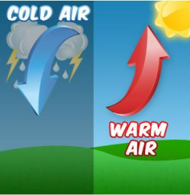
A general rule of weather forecasting is that when low pressure moves in, it will bring stormy weather. High pressure will usually bring good weather.

Slide 6
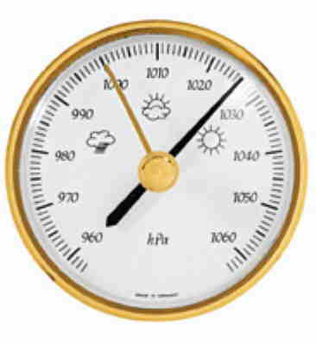
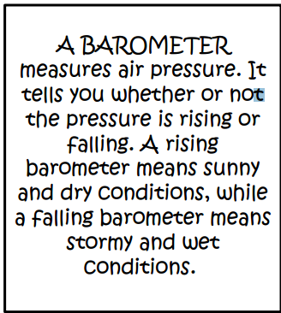

Slide 7
What is Wind?
Wind is air moving in the atmosphere and is caused because of differences in air pressure caused by temperature differences.
Cold air molecules are closer together, so cold air has higher air pressure. Warm air molecules move faster and are farther apart, so warm air has lower air pressure. As the sun warms the Earth's surface, the atmosphere warms too. Some parts of the Earth receive direct rays from the sun all year and are always warm. Other places receive indirect rays, so the climate is colder. Warm air weighs less than cool air and rises. Then cool air moves in and replaces the rising warm air. This movement of air is what makes the wind blow.

Slide 8
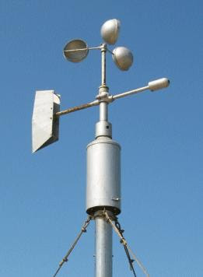
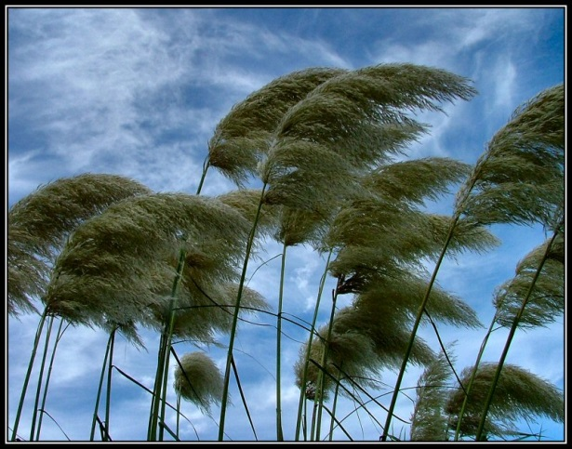
How Do Meteorologists Know Wind Speeds?
Anemometers are tools used to measure the speed of the wind.
60 MPH

Slide 9
What is a Thermometer?
A thermometer measures the air temperature. Most thermometers are closed glass tubes containing liquids such as alcohol or mercury. When air around the tube heats the liquid, the liquid expands and moves up the tube. A scale then shows what the actual temperature is.

Slide 10
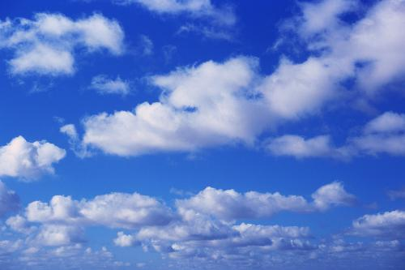
What is a Cloud?
A cloud is a large collection of very tiny droplets of water or ice crystals. The droplets are so small and light that they can float in the air.

Slide 11
All air contains water, but near the ground it is usually in the form of an invisible gas called water vapor. When warm air rises, it expands and cools. Cool air can't hold as much water vapor as warm air, so some of the vapor condenses onto tiny pieces of dust that are floating in the air and forms a tiny droplet around each dust particle. When billions of these droplets come together, they become a visible cloud.

Slide 12
How Does Rain Form?
Water droplets form from warm air. As the warm air rises in the sky it cools. Water vapor (invisible water in the air) always exists in our air. Warm air holds quite a bit of water. For example, in the summer it is usually very humid. When enough of these droplets collect together, we see them as clouds. If the clouds are big enough and have enough water droplets, the droplets bang together and form even bigger drops. When the drops get heavy, they fall because of gravity, and you see and feel rain.

